Slide 1
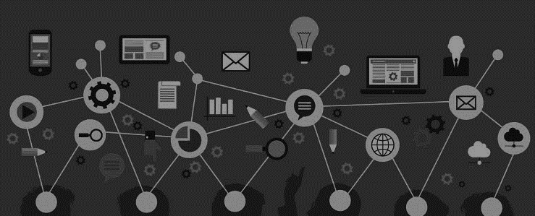






YUKTI Innovation Challenge 2023
Institution’s Innovation Council (IIC),
Ministry of Education’s Innovation Cell
Submission of Assignments 1-5 for 1st Stage Evaluation
Proto ID:
IIC Institute Name: New Horizon College of Engineering
Team Lead Name:
Theme/Sector of Focus: Smart Education
Team Members:
H S YASHAS 1NH21EC063
FAIZAN 1NH21EC069
KUMARGOUDA PATIL 1NH21EC081
STEM Education for Underprivileged Communities

Slide 2
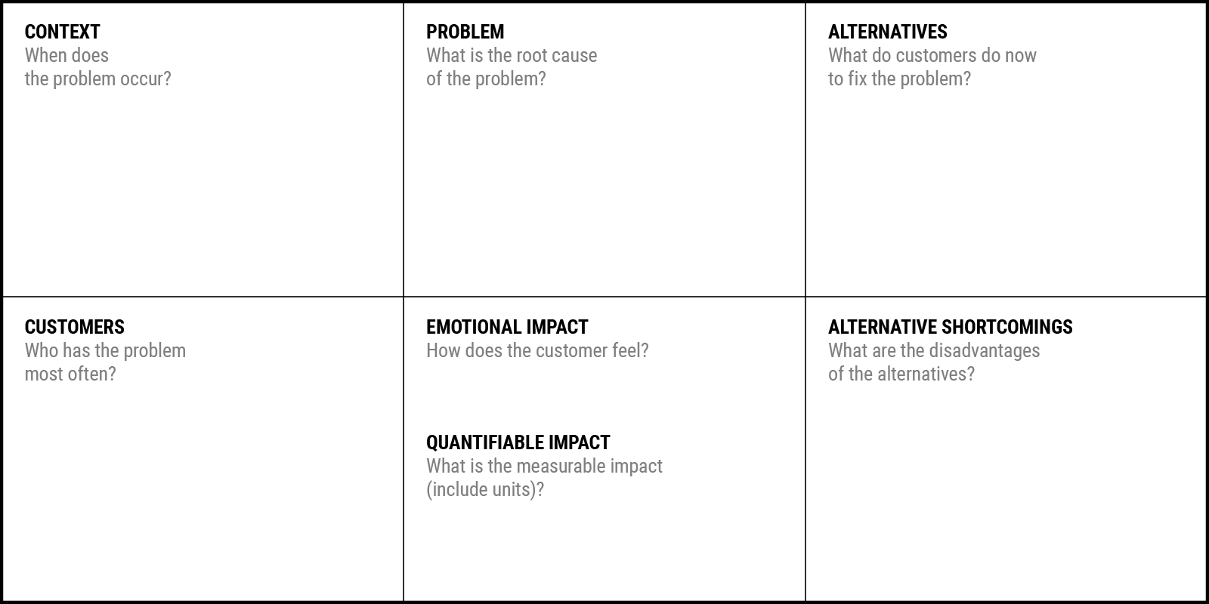
Problem Statement Canvas
YUKTI Proto ID:
Idea/Innovation Title:
Date of Submission:
Who is your Customer Segment:
Prepared By:
Contact No:
During Formal Education
During Critical Development Stages
During Transitional Phases
During Economic Shifts
Across Generations
Throughout the Academic Year
After-School Hours
Socioeconomic Disparities
Educational Infrastructure Inequities
Teacher Shortages and Quality
Digital and Technological Divide
Systemic Inequities in Education Policy
Cultural and Societal Perceptions
Limited Community Support and Engagement
Self-Study and Informal Learning
Participation in Community Programs
Seeking Scholarships and Financial Aid
Engagement in Extracurricular Activities
Utilization of Free Online Resources
Informal Mentorship and Guidance
Isolation Inadequacy Empowerment Determination
Underprivileged Students
Students Attending Underfunded Schools
Students Facing Economic Hardship
First-Generation College Students
Girls and Women
Students in Rural Areas
Minority and Marginalized Groups
Limited Resources and Infrastructure
Quality and Scope of Programs
Dependency on External Factors
Limited Parental Involvement
Barriers to Engagement
STEM Achievement Gap Over Time
Technology Access Disparities
Graduation Rates in STEM Fields
Academic Achievement Disparities

Slide 3
1. The Overview
Create a very high-level overview of your product or service
access to quality STEM education resources and opportunities, empowering students to thrive in the digital age.
STEM education initiative dedicated to bridging the opportunity gap in underprivileged communities.
LEARN NOW

Slide 4
2. The Problem
What problem are you trying to solve? Is it really a problem?
Limited access to STEM resource
Target-underprivileged students, support organizations
Engaging and interactive materials
Few opportunity in hands-on learning experience
Virtual labs, simulations, project based learning.
Key elements- Technology integration, mentorship network, community engagement.
Technology-LMS, VR and AR, Data analytics, online collab tools
LEARN NOW

